Slide 1
TAIWAN STARTUP ECOSYSTEM & IAPS SERVICE
Michael LIN, Ph.D.
CEO
Center of Industry Accelerator and Patent Strategy, NYCT
michaellin@mail.nctu.edu.tw
+886-3-6230124
+886-926-195-747

Slide 2
GENERAL INFORMATION

Slide 3
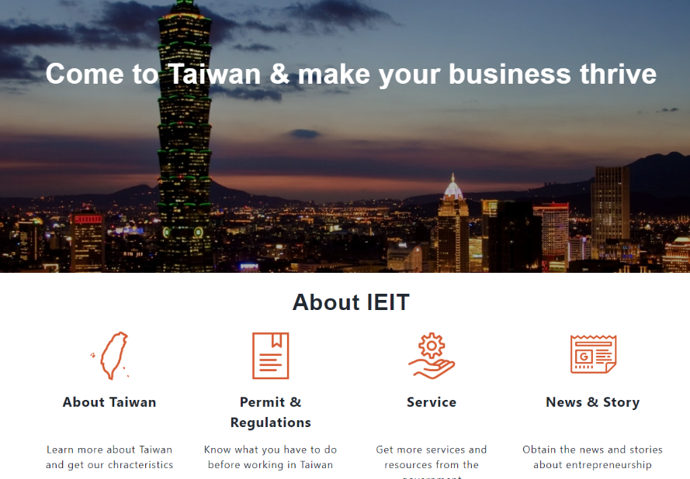
A GLANCE AT TAIWAN
Area: 36,000 square kilometers
Population: 23 million
Language: Mandarin / Taiwanese / Hakka / Indigenous Languages
Religion: Buddhism / Taoism / Christianity / Catholic / Islam
The Small and Medium Enterprise Administration (SMEA) of the Ministry of Economic Affairs began implementing its incubation policy in 1997. Fruitful results have been yielded since then. Over the years, 130 incubators received cumulative subsidies of NT$3.3959 billion from the SMEA, and over 15,000 SMEs were incubated, maintaining and increasing employment opportunities by over 300,000. This led to investments and capital increase by over NT$148 billion, and assisted 116 enterprises in successfully going public (OTC).
https://startup.sme.gov.tw/

Slide 4
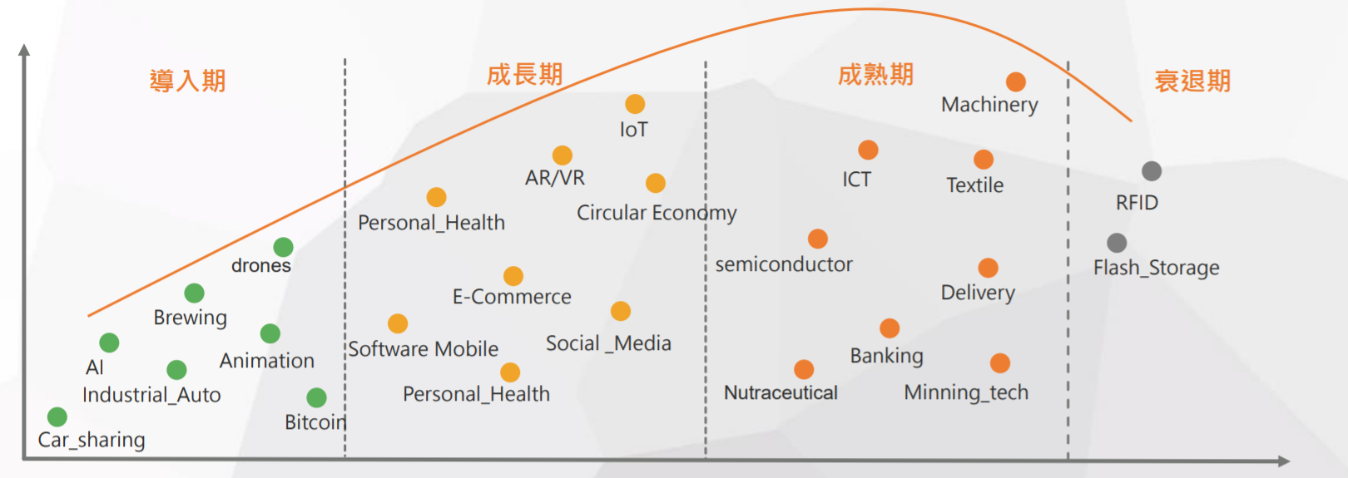
INDUSTRIAL INNOVATION & TRANSFORMATION
The number of SEMA firms are 1.49M in 2019.
The SEMAs are 97.64% of total firms in Taiwan.
The 8.96M workers, employed by SMEA, are 78.41% of employed population in Taiwan.
The startups, funded less than one year, are 102,189 firms in 2018.
357,000 firms operate more than 20 years facing the challenge of innovation.
Embryonic
Growth
Maturity
Decline

Slide 5

ENTREPRENEURIAL SURVEY(1/2)
The 2018 Taiwan Startup Ecosystem Survey is based on an online survey and interviews, which were conducted between 20 March and 10 July 2018.
The total survey population was 3,500, and 317 valid completed surveys (out of a total of 367) were collected, of which 178 respondents had already formally registered as companies in Taiwan.
70%
of entrepreneurs started a
business for the first time
AGE
<30 [13%] ; 31-40 [46%] ; 41-45 [21%] ; >45 [20%]
GENDER
M [61%] ; F [39%]
ACADEMIC BACKGROUND
Business related [57%] ; IT [13%] ; Engineering [13%] ; Science [7%] ; Other [10%]
PIOR WORK EXPERIENCE
Had a job before [94%]
STARTUP EXPERIENCE
1st time [70%] ; 2nd time [23%] ; 3rd time [3%] ; Over 3 [4%]
would consider a takeover
from a large scale company
68%
target China as their main
overseas market, followed
by SE Asia, North America
55%
are willing to cooperate
with larger companies to
develop products/services
48%

Slide 6
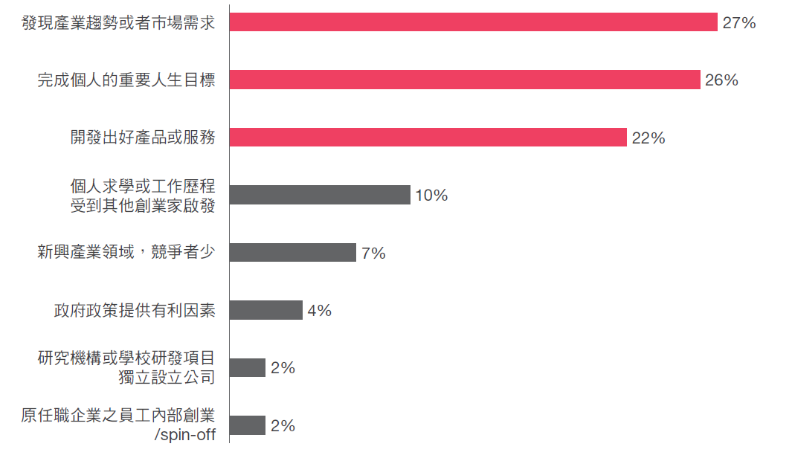

ENTREPRENEURIAL SURVEY(2/2)
Demand from Industry/ Market
Personal Goal
Unique Product/ Service
Inspired by Other Entrepreneurs
Opportunity in Emerging Industry
Encouraged by Gov. Policy
Spin-off from R/D Institute or University
Spin-off from Private Company

Slide 7

ENTREPRENEURS’ CHALLENGES
Fund Raising
28%
Company Management
13%
Valuation
Marketing &
Business Expansion
24%
Core Competence
in Service/ Product
4%
Competiveness
Market Position
Team Members
14%
Regulation/ Tax
13%
Vision
Emerging Technology

Slide 8
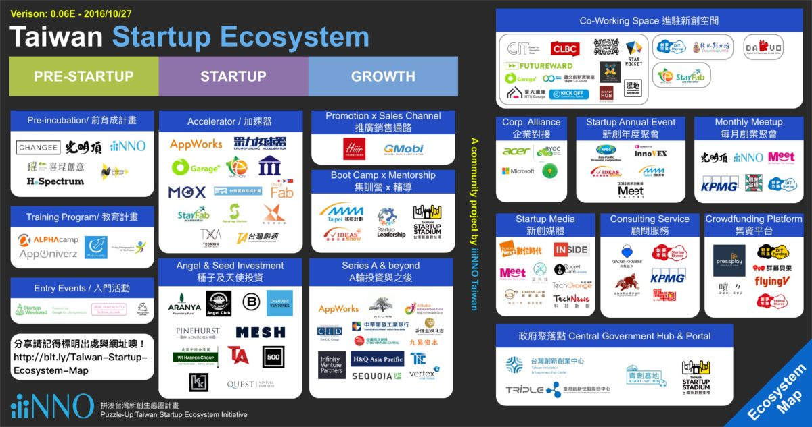
TAIWAN STARTUP ECOSYSTEM

Slide 9




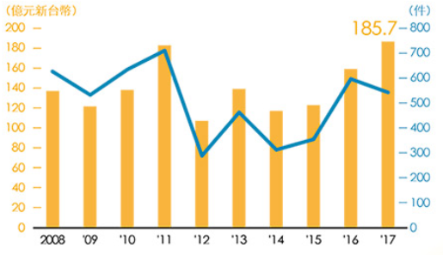
TYPES OF INVESTORS
FAMILY
FRIEND
FOOL
ANGEL
TX VENTURE
Taipei Angels
SVT Angels
Seed round investment
NT100M/ Year
Case/ Year
VENTURE CAPITAL
CORPORATE VC
FOXCONN
Chunghwa Telecom
WISTRON
New investment model in the world
CVC department for startup investment, M&A
Looking for new opportunity of growth
Total number of VC is 269 in 2019.
8.8% Investment of VC in seed-stage startup

Slide 10

























NEW GROWTH & COOPERATION
Corporates
Corporate + Startups
▲ Corporate Venture Capital: Strategic investments in startups
▲ Partnership outside of investment: Acquisition/Joint venture
▲Establish an outpost in tech hubs to learn latest tech trends
▲Example: Silicon Valley, Boson, Tel Aviv, etc.
Corporate
Startup
Engagement
▲ Internal innovation
▲ In-house R&D team leads corporate innovation and develops new products
Corporate
Innovation
Outposts
Corporate
Venturing
Corporate
R&D Labs
External Innovation
1920-1990
1990-2010
2010-2016
2017～
Source: Institute for Information Industry (MIC)
Notes:
Corporation Aspect: New Growth, New Cooperation
Corporation + Corporation
Internal Innovation
Corporation controls the development of new products
Early Financial Investment: investment return on idle assets
Later Strategic Investment: acquisition/joint venture/cooperation/authorization
Corporation + Startup
Set up a based in an innovation city
I.e. Silicon Valley, Boston, Tel Aviv
Open innovation
Actively incubate new startup teams

Slide 11
GOV. POLICY IN INCUBATION AND ACCELERATOR

Slide 12

















GLOBAL TREND
Value Chain Creation in Accelerator/Incubator
Profit-oriented and paid service are booming.
Multi-Spaces
Funding Service
International Marketing
Professional Assistance
Commercialize Service
Financial industry, such as angel
Network with entrepreneurships and global market
Service providers that help strengthen entrepreneurships
Market test, Sales channel
Focusing on empirical studies about entrepreneurship products.
Working spaces

Slide 13

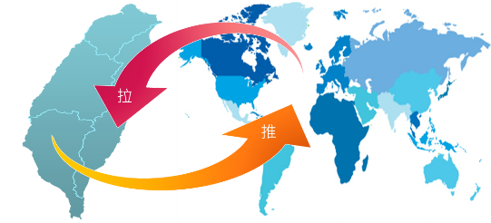






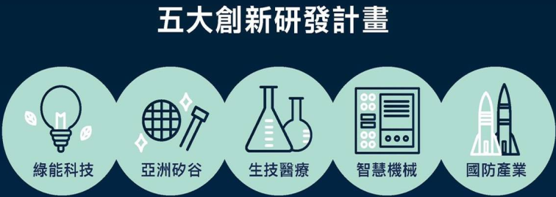


STRATEGIC PLANNING
Value chain of the accelerator and incubation
Space Provided
Pull
Funding Service
Local-Connection
Marketing Service
Global-Connection
Push
Professional Consulting
Transnational Co-incubation
Cooperation of international league
Strategy 2：PPP
Public-Private Partnerships
Commercialize Service
Strategy 3：First station of entrepreneurship in Asia-Pacific
Future-Connection
Establish positivism basement
Promote innovation sandbox
Create innovation atmosphere
Green Energy
Technology
Silicon Valley
Of Asia
Biotechnology and
Medical Care
Intelligent
Machinery
National Defense
Industry
Digital
Economy
Circular
Economy
Strategy 1：Innovation Positivism
4
Notes:
Vision：Cultivate the private innovation and incubation system and build the network of Asia-Pacific entrepreneurship ecosystem through three promoting strategies.

Slide 14
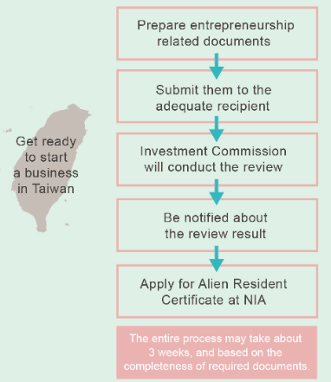
TAIWAN ENTREPRENEUR VISA
▇ Received venture capital investment or international fundraising of more than NT$2 million.
▇ Received approval to reside at a recognized innovation park or incubator in Taiwan.
▇ Obtained patent rights or professional skills certificate.
▇ Has been awarded in a leading startup or design competition, or has been involved in a foreigner entrepreneurship project in Taiwan.
▇ Has been or is currently located in a startup accelerator recognized by the Taiwanese government.
▇ The enterprise or the person in charge of the enterprise has been nominated or awarded in a film festival.
▇ Received innovation subsidy of at least NT$3 million from the central government or at least NT$1 million from the local government.
▇ Possesses innovation capability specified or recommended by the Taiwanese government.
▇ Has established enterprise with innovation capability in Taiwan and acts as its legal representative, manager or director with an investment of at least NT$1 million.

Slide 15
ACCESS TO TAIWAN

Slide 16
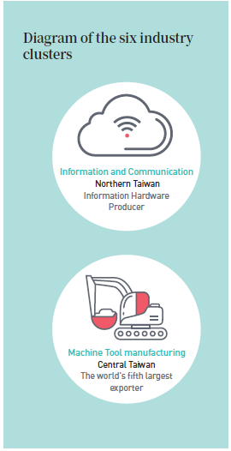
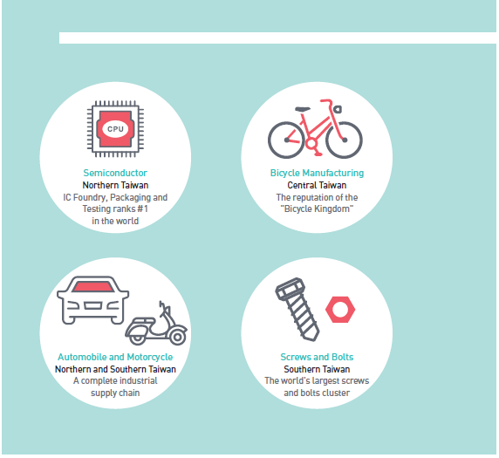

HIGH-QUALITY INDUSTRIAL CLUSTERS
Taiwan's manufacturing clusters occupy a place in the global supply chain and is an important foundation for the development of Taiwan's industries.
Source: Institute for Information Industry (MIC)
Notes:
Taiwan has the Foundation for High-Quality Industrial Clusters
Taiwan's manufacturing clusters occupy a place in the global supply chain and is an important foundation for the development of Taiwan's industries.
Information Technology Cluster
Northern Taiwan
Information hardware manufacturing power
Semiconductor Cluster
Northern Taiwan
Number 1 IC OEM and tester
Bicycle Cluster
Central Taiwan
Nicknamed “The Land of Bicycles”
Machinery Cluster
Central Taiwan
One of the 5th largest exporters
Automobile Cluster
Northern and Southern Taiwan
Complete manufacturing supply chain
Fasteners Cluster
Southern Taiwan
The world’s largest fasteners cluster

Slide 17
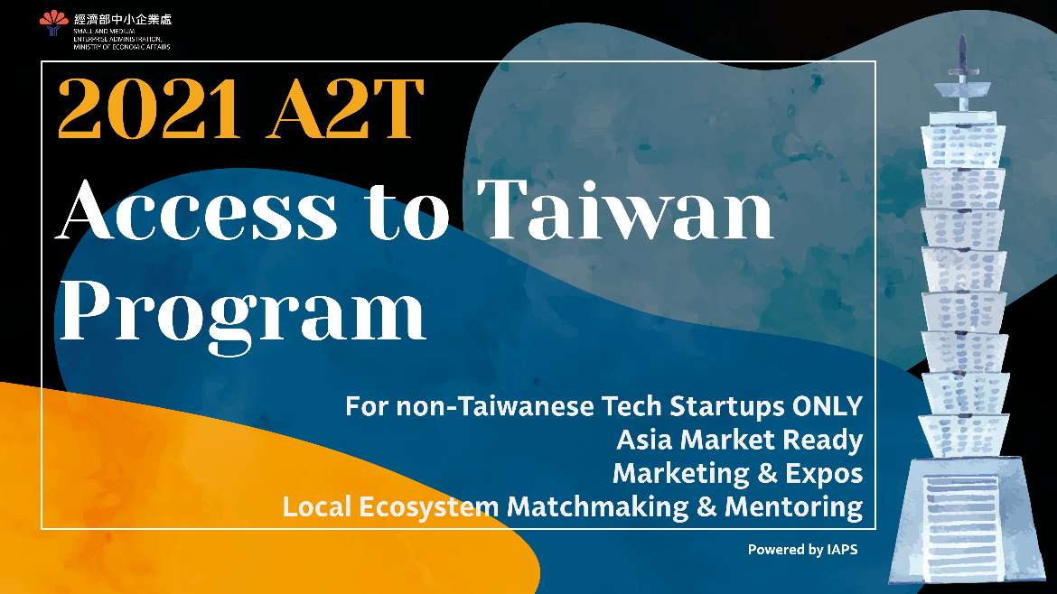



A2T PROGRAM
Startup Needs
A2T Program
Online Acceleration
Concall Confirmation
Online Mentoring
DEMO pitching and exposure opportunities
Online call regarding setting up a company
Manufacturing & Verification
+
Asian Market
【Application Period】
Batch 1 : January 1st – February 10th
Batch 2 : May 24th – June 25th
【Acceleration Period】
Batch 1 : March - June
Batch 2 : July - October
Offline Softlanding
Offline exhibition: InnoVEX、Meet Taipei
Business meeting in person
Administration help regarding company establishment
Connect with TACC+
Talents

Slide 18
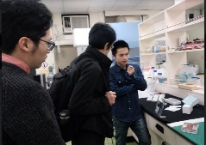

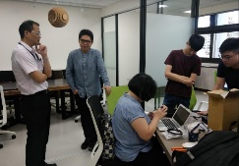
CSE IN A2T
“Building a powerful and effective interface to partner with startups is not a small task. But productive startup engagements are worth every mile you go, and will quickly become an indispensable tool in the innovation toolkit of your company.”
~Peter Borchers
CSE
Corporate Startup Engagement
Joint collaborative project between corporate and startup
Corporate introduce clients to startups for business marketing.
CSE Practice in IAPS
Corporate provides technical support to startups.
Connect to strategy investment department
We had successful collaborative case between startups and giant companies in Taiwan.

Slide 19
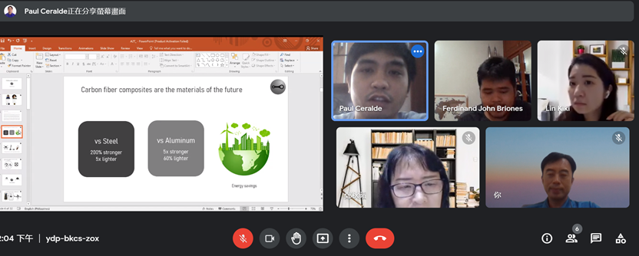
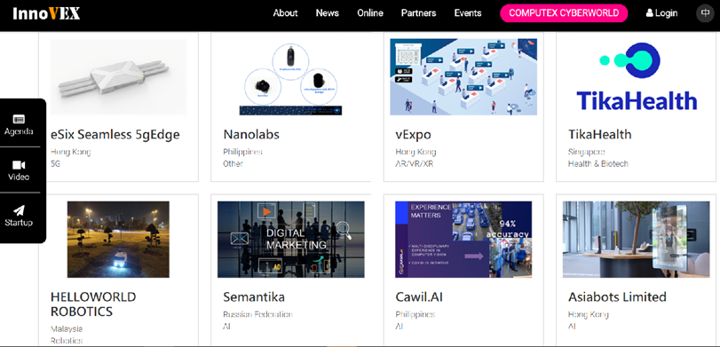
A2T PROCESS & GOALS
Local Rep. & Office
Business Connection
Meet with Investors
I： Evaluation & Mentorship
  Online application ( please check out IAPS official website for more information)
  Virtual meetings to discuss the business plan
  Set up milestones and A2T program package
  Online mentoring sessions
  Ongoing support and follow up
II： Local Ecosystem Matchmaking
  Arrange meetings with potential partners and clients in Taiwan
  Provide related landing services
III：Marketing & Expos
  Arrange to exhibit at startup expos in Taiwan
  Arrange pitch opportunities according to startups’ fundraising needs
On-line Meeting
On-line EXPO

Slide 20
IAPS ECOSYSTEM

Slide 21


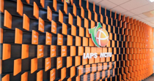




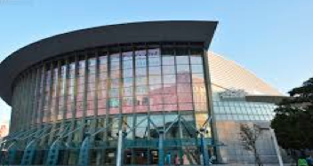



IAPS PROFILE
Established in 2013
University-affiliated
About 30 staffs in the center
Operation Domain:
2015 ASIA #1
2015 GLOBAL #7
Hsinchu
@IAPS HQ
Startup
Acceleration
International
Connection
Industry
Matchmaking
Taipei
@Taiwan Tech Arena
Incubation
Coaching
Startup
Investment
Think
Tank

Slide 22
IAPS ACCELERATOR PROGRAM
Taiwanese Startups
International
Startups
University Spin-offs
Vertical
Accelerator
ACCESS TO ASIA | A2T | RSC | HYPE SPIN 5G Accelerator InnoMED
Entering Asian Market
International Selection
Mentoring and Funding Evaluation
4-month Program
DEMO DAY
Connecting Taiwanese Industries
Partnership with Incubations
Mentorship and Matchmaking
6-month Program
DEMO Pitch
Combining exhibitions such as InnoVEX and Meet Taipei
Sprinting Academic Teams to Spin-off
Mentoring and Funding Evaluation
2-4 years of Cultivation
Industry Innovation Projects
Ecosystem Integration
Mentorship and Matchmaking
DEMO DAY
4-month Program

Slide 23



SCALE-UP PREMIUM PROGRAM
MODEL
Leverage mentor’s network to promote startup value by tripartite contract.
Discover the potential value of startups, increase investment profit.
Success
Product or services pass verification.
Next round funding
International strategy planning
Core team assembled.
Promising Startups
Key talents
Ready to explore international market
Ready Prototype
Sufficient working capital
IAPS Mentors
IAPS x TX FUND
Mentor’s Accompany
Investment due diligent
Investor referral
Investment gains payback
Seasoned mentor
One on one consulting
Market-oriented assistance
Proper incentive to mentor
IAPS PROGRAM
Setting milestones
Milestones with feasibility of implementation
Regular reviews by tracking
Flexible Adjustment.
Fund raising preparation
Valuation with reason
Investment Roadshow

Slide 24







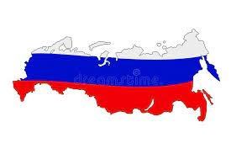










ASIA-PACIFIC ACCELERATOR NETWORK
Regional Business Development with potential joined investment
Co-sponsored Innovation programs
Think Tanks for regional innovation and business studies
AAN Association
Initiated by investors and accelerators.
Good connection with startups in Digital-health, Med-tech, Bio-ICT fields.
The night of AAN SPOTLIGHT promotes startup regularly.

Slide 25
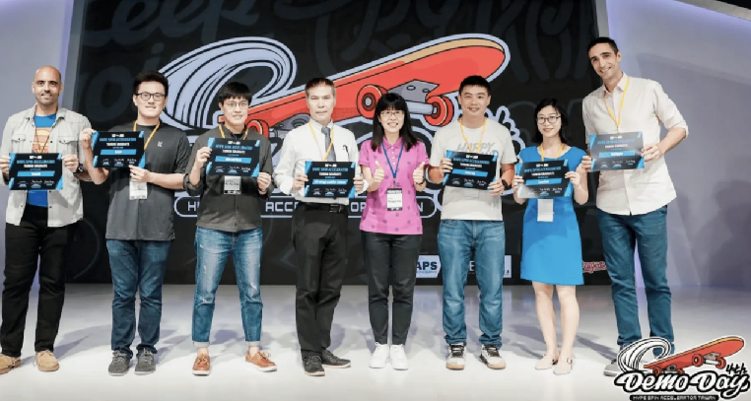
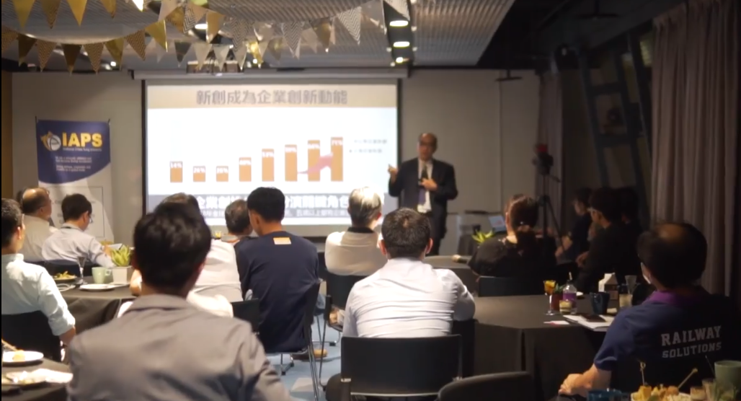

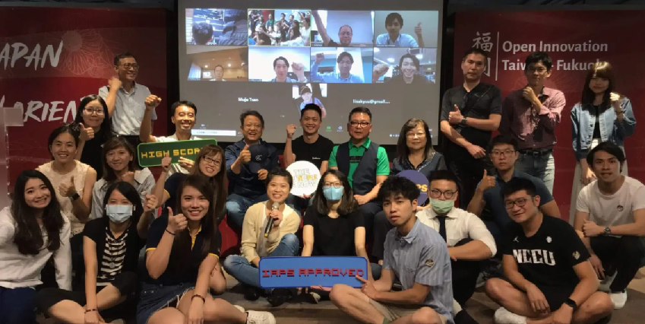
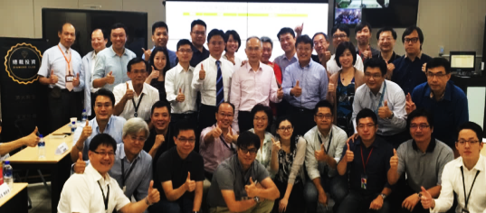
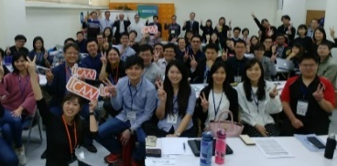
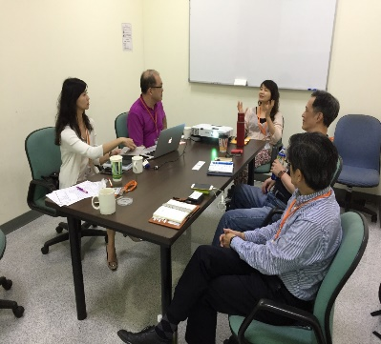
IAPS ACTIVITY
IAB Workshop
Startup DEMO DAY
SPOTLIGHT night
Sports Accelerator DEMO DAY
SPOTLIGHT
Investment
Matchmaking
Business Matchmaking
Startup Networking
Japan Open Innovation Program
Various Workshop
and Courses
Foxconn VP Matchmaking Session
IAPS Mentor Session
Startup Mentality Workshop
Mentor Session

Slide 26
EARLY-STAGE INVESTMENT
Fund Size：92 million TWD
Focus Funding Rounds：Angel + Pre-A/A
Interested Sectors：Agriculture, Medical, Sports, Smart IoT
Per Case Investment：1million-15million TWD
A
Startups
Recommendation
B
Internal
Evaluation
Added Investment
5-10 million → high growth and clear international market segment companies.
Two-stage investment
C
Due Diligent
1~2 million NTD + business acceleration → 2-3 times estimate value growth.
D
Investment Committee
Initial Investment

Slide 27

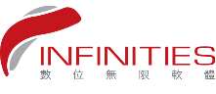





















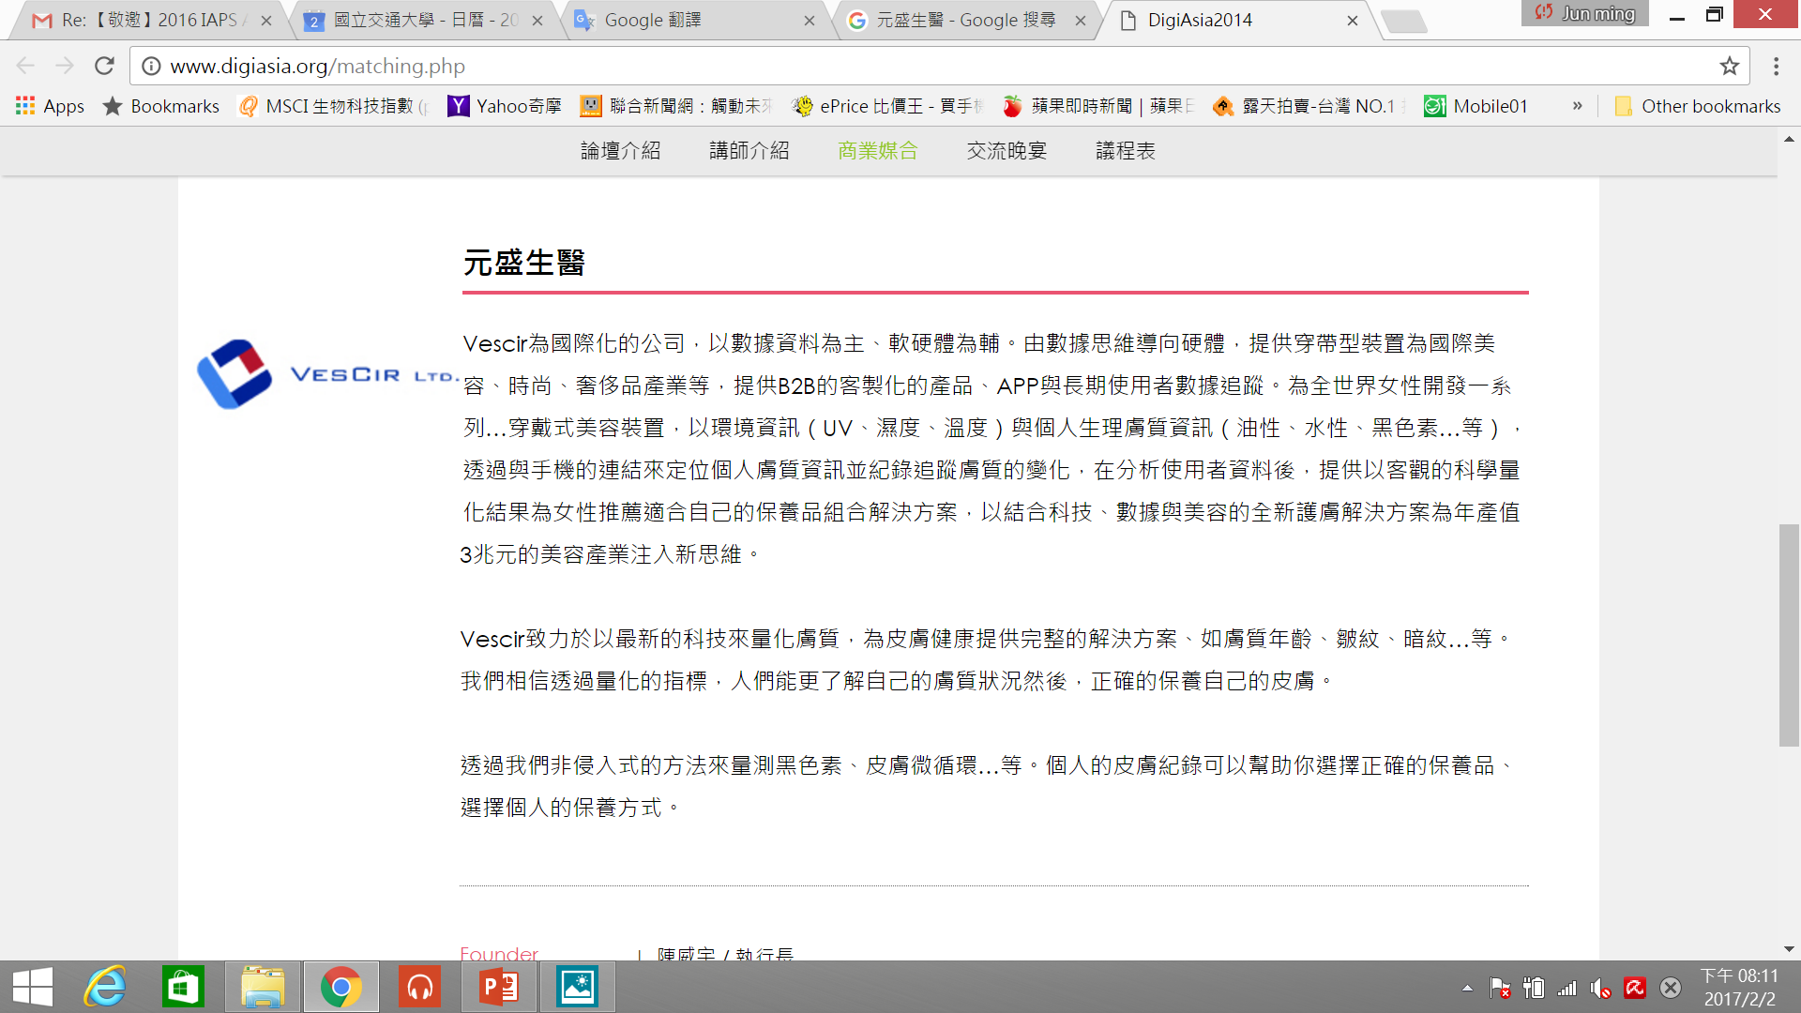






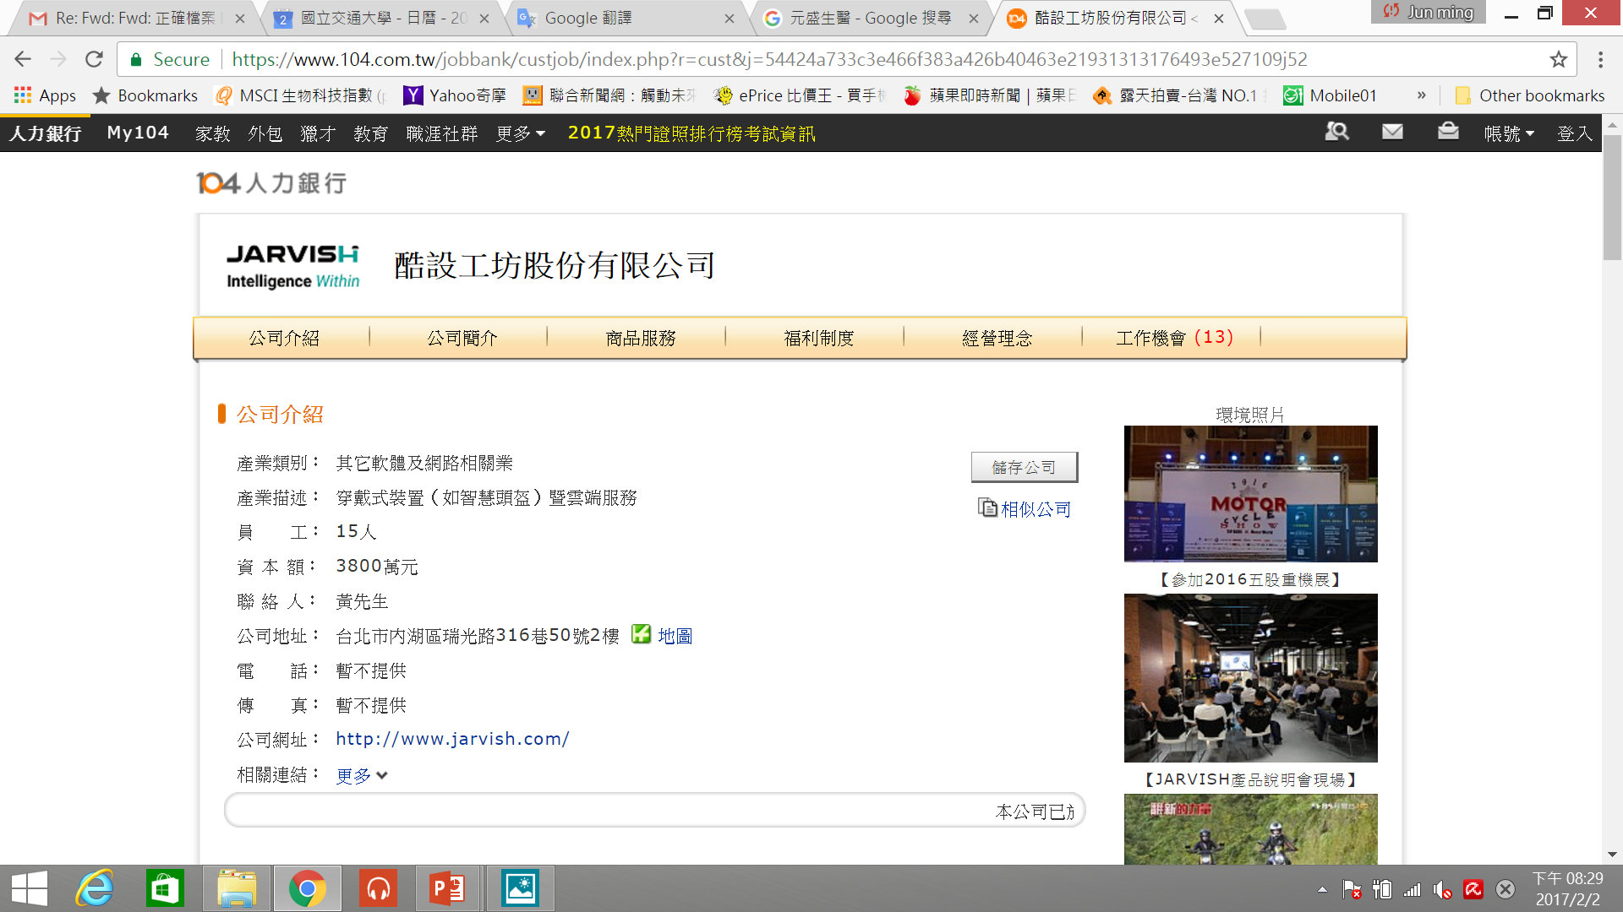
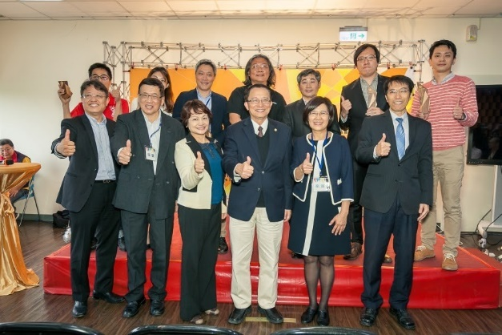
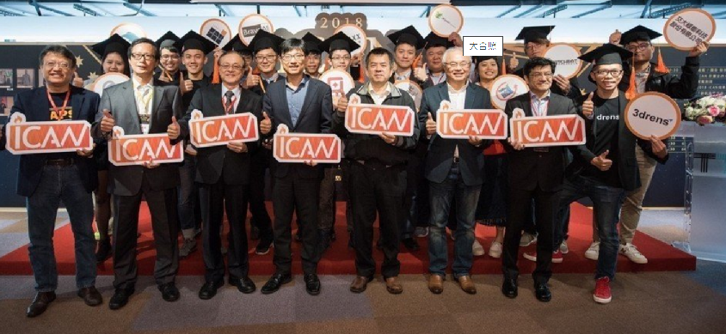
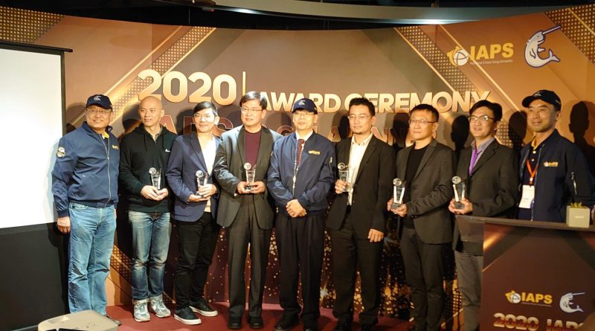
IAPS AWARD
2016 2017 2018 2019 2020

Slide 28
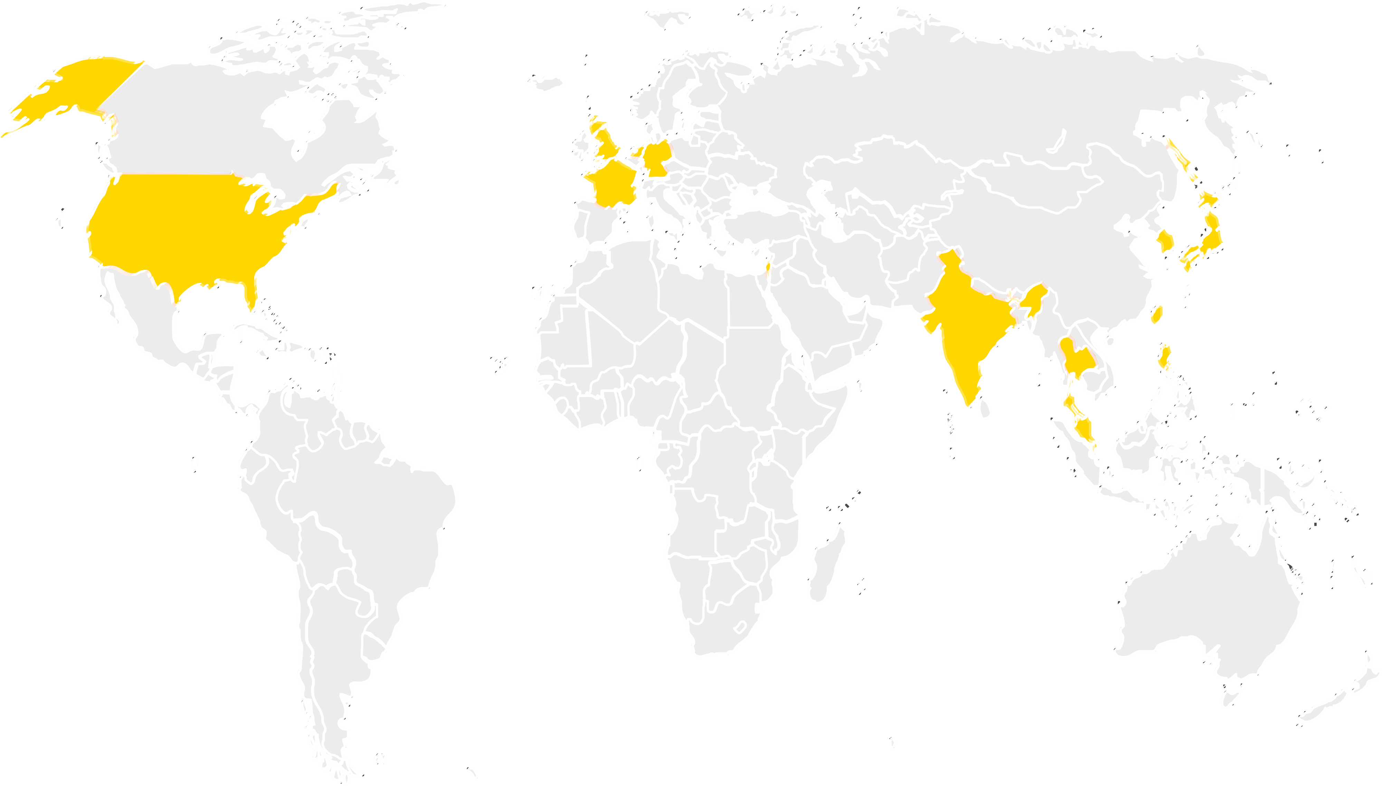

IAPS ECOSYSTEM
Funding Service
Angel Investment Platform/ TX Venture
[Direct Investment to startups]
[Accelerate startups to acquire capital]
CEO Club
[Dialogue with big corporate]
Corporate Engagement
Business Matching
[Build up partnership]
Peers Group
[Share experience & networks]
Startup Community
Marketing Service
Go Global
[Select qualified startup to connect overseas partner]
Taiwan Tech Arena
[Global Startup Hub]
Space Provided
Strategy Consulting
Soft-Landing
[Business gateway for foreign startups]
HsinAn
[High-tech cluster]
CXO Mentorship
[High impact, critical thinking]

Slide 29



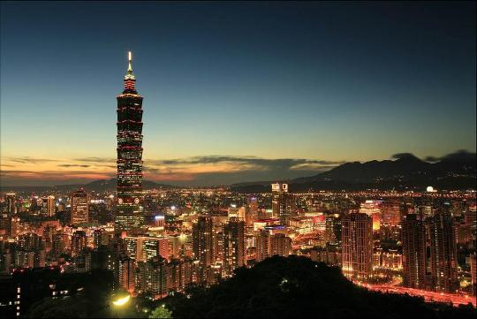
SUMMARY
Largest Innovation Ecosystem in Taiwan
Taiwan’s Competitiveness is beyond our Imagination
Facilitate international startup to leverage Taiwan top manufacturing system.
Ranked as the Best Quality of Life in the world by Inter Nations, 2018
01
02
Position Taiwan as the first Stop in Asia for international startup.
Taiwan is Asia #1 “Super Innovators” by WEF, 2018
Create opportunity for young educated talents by cross-national collaboration.
03
Taiwan is the leading country in mobile consumption and social media acceptance.
04
Strengthen AAN capability in startup investment.
05
Build the regional startup value chain up to accelerate the economic growth.
Notes:
臺灣文化對創新事物接納度高，新興網路平台及數位內容的消費大國。如: 2016年「過去七天有使用LINE」的臺灣民眾高達91％：使用FB等社群平台達6.16天/週。

Slide 30
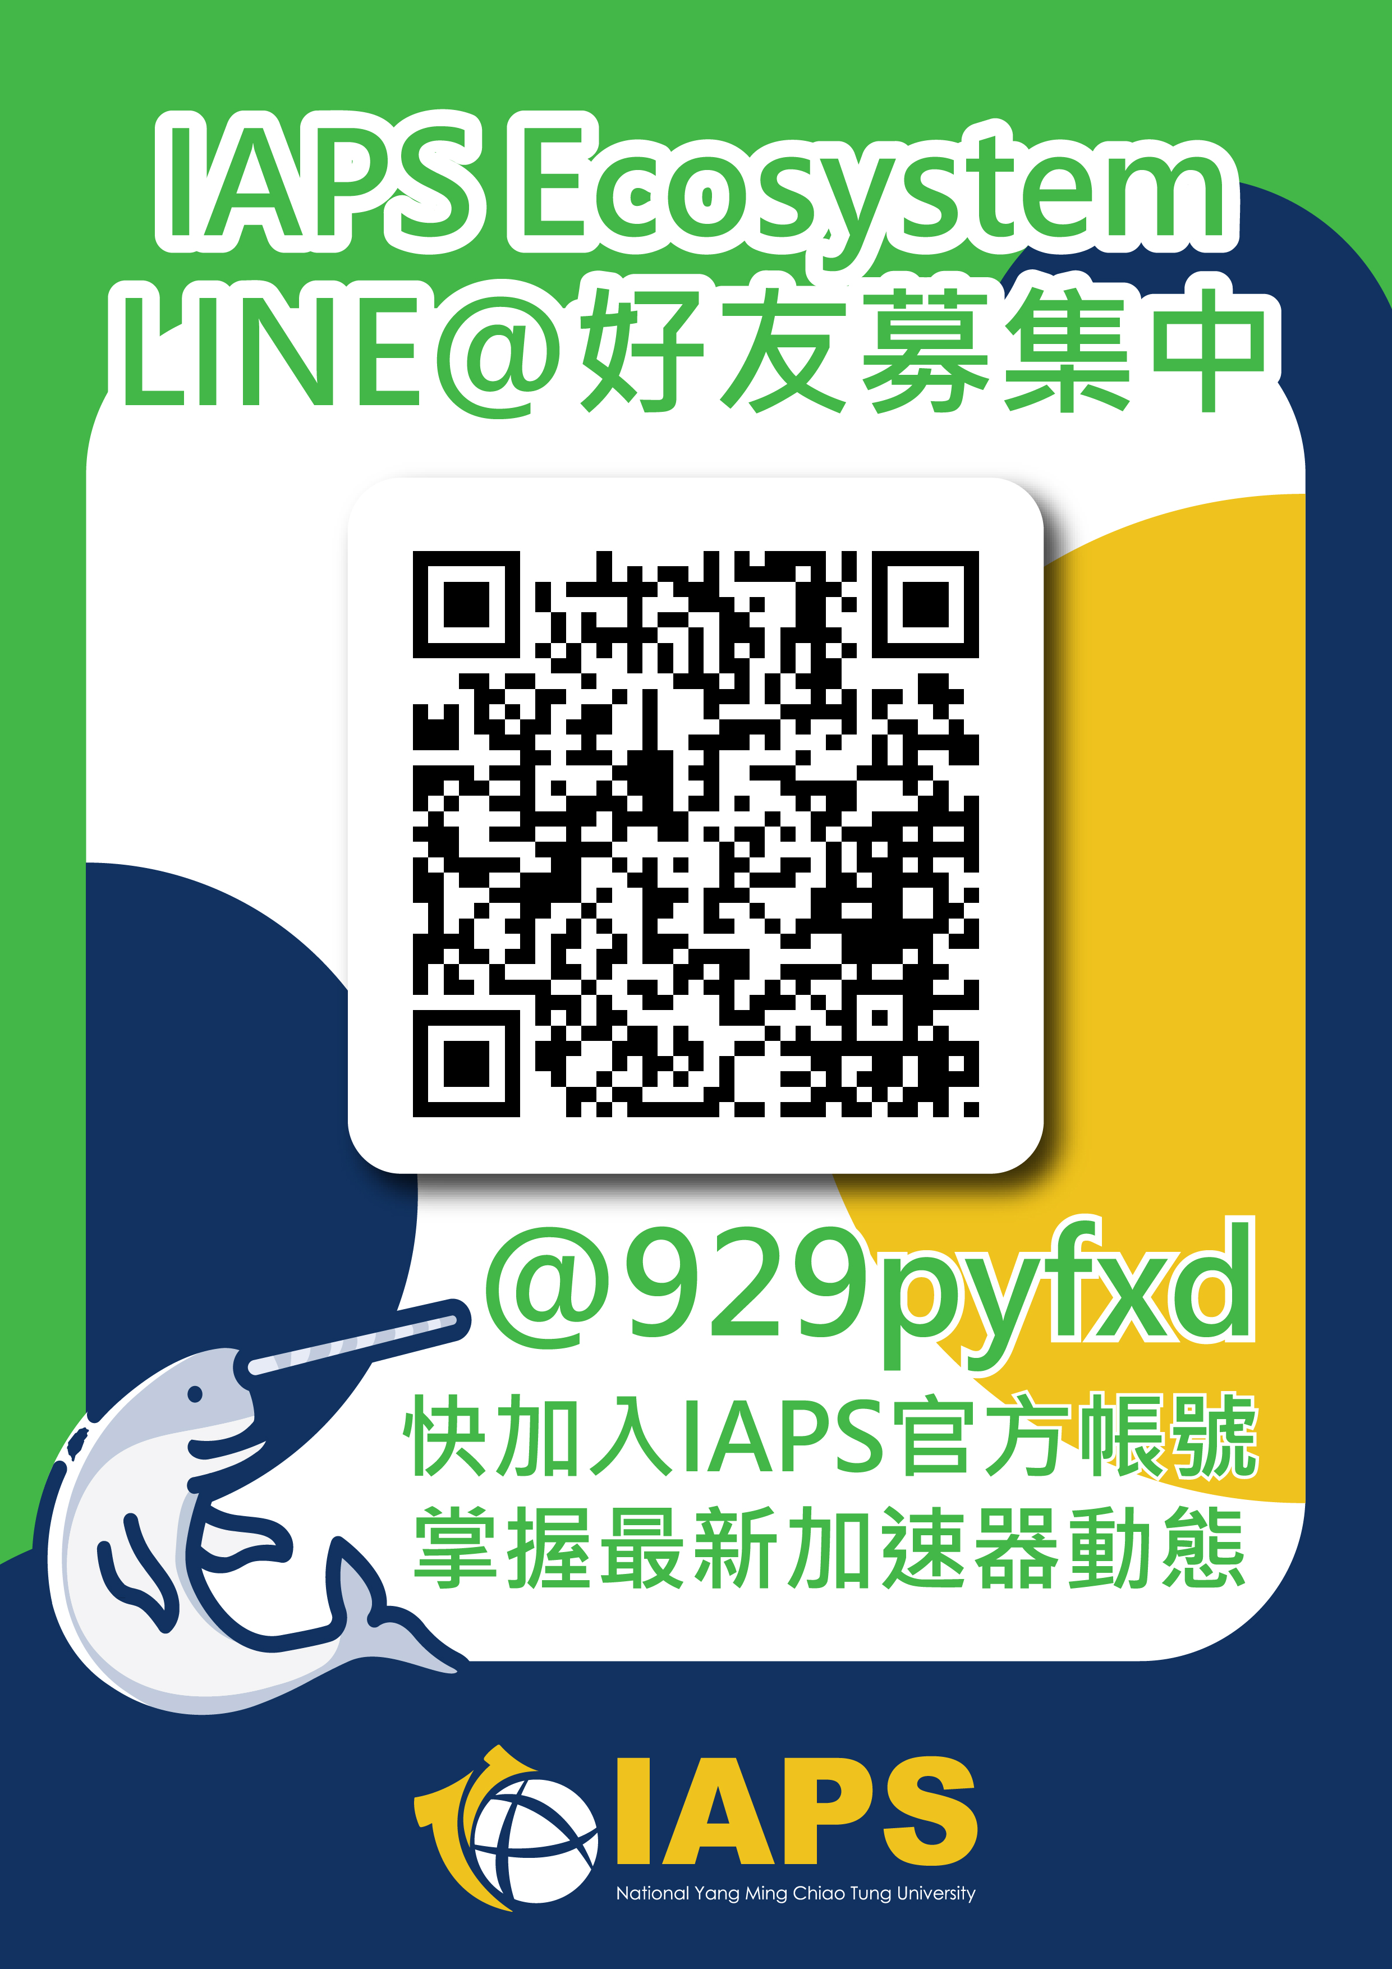
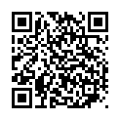

Q&A
Facebook
Official Website
https://iaps.nctu.edu.tw/
Michael Lin
Phone：+886-3-6230124 / +886-926-195-747
E-mail： michaellin@mail.nctu.edu.tw

